Slide 1
Activity Diagram
CSE-327
Section:09
Group:02
Members:
Adnan Prince Rahman - 1911053642
Md Aminul Islam Sayem - 1911826042
Fuyad Mahmud - 1921853642

Slide 2
Specialized Doctors info and Appointment
Md Aminul Islam Sayem - 1911826042
Patients
Help Desk
Technical support
System
Start
Solve the problem
Book Appointment Manually
Search
Booked Appointments
Need Help?
Yes
No
Calculate Payment
Search
Doctor
Search doctor by
Diseases type
Enter Patient’s details To booked appointment
Book Appointment
Time
Need Help?
Yes
No
Fill Information
Accept as Order
End

Slide 3
Hospital & Diagnostic info and Appointment
Md Aminul Islam Sayem - 1911826042
Patients
Help Desk
Technical support
System
Start
Book Appointment Manually
Solve the problem
Search
Booked Appointments
Need Help?
Yes
No
Calculate Payment
Search
Hospital
Search
Diagnostic
Enter Patient’s details To booked appointment
Book Appointment
Time
Need Help?
Yes
No
Fill Information
Contact Support
Accept as Order
Yes
No
Review Bill?
End

Slide 4
Request for Ambulance
Md Aminul Islam Sayem - 1911826042
Patients
Help Desk
Technical support
System
Start
Book reservation Manually
Solve the problem
Search Ambulances
Booked reservation
Need Help?
Yes
Type
No
Calculate Payment
AC
Non-Ac
Enter Patient’s details To booked reservation
Emergency
No
Yes
Time
Fill Information
Find nearest Ambulance
Need Help?
Yes
Get Driver’s
info
Contact Support
Accept as Order
Yes
No
Review Bill?
End

Slide 5
Subscription
Md Aminul Islam Sayem - 1911826042
Patients
Help Desk
Technical support
System
Start
Fill info Manually
Solve the problem
Get Subscription
Confirmed
Need Help?
Yes
No
Yes
No
View info only
Accept Terms & Cond.
Enter Subscriber’s details To give subscription
Time
Need Help?
Yes
Calculate Payment
No
Fill Information
Contact Support
Yes
Accept as Order
Review Bill?
No
End

Slide 6
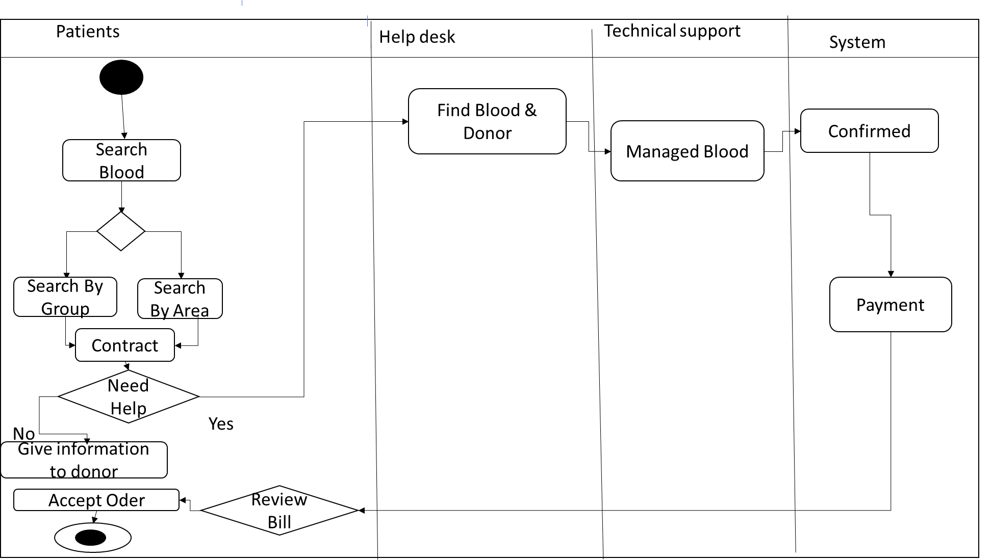
Fuyad Mahmud - 1921853642
Find Blood
Start
Time
End

Slide 7
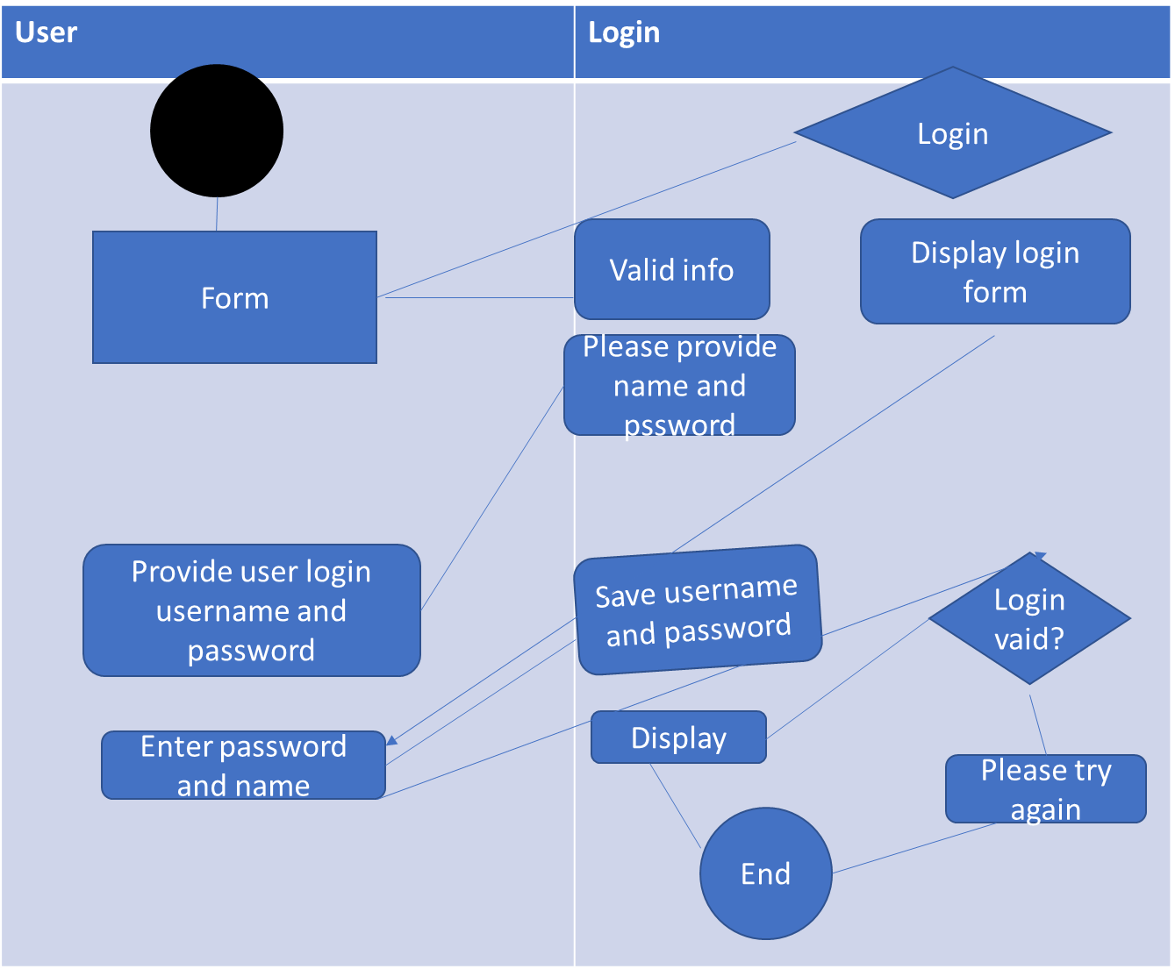
Adnan Prince Rahman - 1911053642
Client Registration

